Slide 1


Daniel Lecheler
8/2/2025

Slide 2

Outline
Executive Summary
Introduction
Methodology
Results
Conclusion
Appendix

Slide 3
Executive Summary
Summary of methodologies
Data collection
Data wrangling
Exploratory Data Analysis with Data Visualization
Exploratory Data Analysis with SQL
Using Folium to build an interactive map
Using Plotly Dash to build a Dashboard
Predicitve Analysis (with Classification)
Summary of all results
Results of Exploratory Data Analysis
Interactive Analytics Demo (screenshots)
Predictive Analysis results

Slide 4
Introduction
Project background and context
SpaceX is the dominant company in space travel as the era of commercial space travel takes flight. With a mission of making space travel accessible and affordable, the company advertises its Falcon 9 rocket launches on its websites which cost an average of $62 million which is almost one tenth of what their competitors are offering. This reduction in total cost is primarily due to the reusing of the first stage of the rocket and therefore the total cost of the launch can be deduced based on knowing whether the first stage landed without issue. Using public information and data combined with machine learning models, this project will predict the if SpaceX will reuse the first stage of their rocket
Problems you want to find answers
How do the following variables effect the success of the first stage of the rocket landing:
Payload mass
Launch site location
Number of flights
Orbits of Earth
Does the rate of the first stage landing successfully increase over time?
What is the best algorithm that can be used for binary classification for this project?

Slide 5

Section 1

Slide 6
Methodology
Executive Summary
Data collection methodology:
Using SpaceX Rest API
Using Web Scrapping from Wikipedia
Perform data wrangling
Filtering the data
Dealing with missing variable values
Using One Hot Encoding to prep the data for binary classification
Perform exploratory data analysis (EDA) using visualization and SQL
Perform interactive visual analytics using Folium and Plotly Dash
Perform predictive analysis using classification models
Building, tuning, and evaluating the classification models to optimize the results

Slide 7
Data Collection
The data collection process combined the use of API request from SpaceX REST API and Web Scraping data from a table in SpaceX’s Wikipedia page
The following data columns were obtained by using SpaceX RestAPI:
FlightNumber, Date, BoosterVersion, PayloadMass, Orbit, Launch Site, Outcome, Flights, GridFins, Reused, Legs, LandingPad, Block, ReusedCount, Serial, Longitude, Latitude
The following data columns were obtained using Web Scraping:
Flight No., Launch site, Payload, PayloadMass, Orbit, Customer, Launch outcome, Version Booster, Booster landing, Date, Time

Slide 8
Data Collection – SpaceX API
Decoding the response content using “.json()” function and turning it into a datafram using “.json_normalize()” function
Requesting information about the launches from SpaceX API by applying user created functions
Request Falcon 9 launch data from SpaceX API
Constructing data obtained into a dictionary
Replacing missing values of the Payload Mass column with the calculated mean of the column
Creating a data frame from the dictionary
Filtering the data frame to only include Falcon 9 launches
Exporting the data to a CSV file
Link to GitHub: Data Collection API

Slide 9
Data Collection - Scraping
Create a BeautifulSoup object from the HTML response
Extract all column names from the HTML table header
Request Falcon 9 launch data from Wikipedia
Request Falcon 9 launch data from Wikipedia
Constructing data obtained into a dictionary
Creating a data frame from the dictionary
Exporting the data to a CSV file
Link to GitHub: Data Collection with Web Scraping

Slide 10
Data Wrangling
Link to GitHub: Data Wrangling
In the data set, there are several different cases where the first stage booster did not land successfully. Some of these involved an attempted landing that failed due to an accident. The following are the different types of outcomes and what they each mean
True Ocean: Mission outcome was considered successful since the landing was in the specific section of ocean that was expected
False Ocean: Mission outcome was considered a failure since the landing was outside of the expected section of ocean
True RTLS: Mission outcome was successful since the landing was on the ground pad
False RTLS: Mission outcome was a failure since the rocket failed to land on the ground pad
True ASDS: Mission outcome was successful since the landing was on a drone ship
False RTLS: Mission outcome was a failure since the rocket failed to land on a drone ship
The true or false first word prefix is converted to the Boolean 1 and 0 to indicate success or failure in the launches

Slide 11
EDA with Data Visualization
Link to GitHub: EDA with Data Visualization
Charts that were plotted:
Flight Number vs. Payload Mass
Flight Number vs. Launch Site
Payload Mass vs. Launch Site
Orbit Type vs. Success Rate
Flight Number vs. Orbit Type
Payload Mass vs. Orbit Type
Success Rate Yearly Trend
Scatter plots were used to show the relationship between variables and if that relationship existed, they were used for machine learning models
Bar charts showed comparisons among discrete categories with a goal of showing the relationship between the specific categories and the measured value
Line charts showed trends in data over time (AKA time series)

Slide 12
Link to GitHub: EDA with SQL
EDA with SQL
SQL queries that were performed:
Displaying the names of the unique launch sites
Displaying 5 records where the launch site began with the string “CCA”
Displaying the total payload mass caried by boosters launched by NASA
Displaying the average payload mass caried by booster version F9 v1.1
Listing the date of the first successful landing on the ground pad
Listing the names of the boosters which have success in drone ship and have a payload mass between 4000 and 6000
Listing the total number of successful and failed mission outcomes
Listing the names of the booster versions which carried the maximum payload mass
Listing the failed landing outcomes in drone ship, the booster version used, and the launch site names in 2015
Raning the count of landing outcomes between the date of 6/4/2010 and 3/20/2017 from most recent to oldest

Slide 13
Link to GitHub: Interactive Visual Analytics with Folium
Build an Interactive Map with Folium
Markers of all launch sites:
The NASA Johnson Space Center is marked with a circle, pop-up label based on it’s exact latitudinal and longitudinal coordinates
All launch sites are marked with a circle, pop-up label based on their exact latitudinal and longitudinal coordinates
Colored Markes of the launch outcomes for each site
Added colors to markers to indicate success (green) or failure (red) using Marker Cluster to identify which launch sites have the highest success rates
Approximate instances between sites
Added colored lines to show distances between the launch sites and geographical indicators (coastline), transportation routes (railway, highway), and urban centers (the closest city)

Slide 14
Link to GitHub: SpaceX Dash App
Build a Dashboard with Plotly Dash
Launch Sites Drop-down List:
Added a drop-down list to enable launch site selection
Pie Chart of Successful Launches:
Added a pie chart to show the total successful launches count for all sites and the Success vs. Failure counts for the site (if a specific Launch Site was selected)
Slider of Payload Mass Range:
Added a slider to select Payload range
Scatter Chart of Payload Mass vs. Success Rate for different Booster Versions:
Added a scatter chart to show the correlation between Payload and Launch Success

Slide 15
Predictive Analysis (Classification)
Summarize how you built, evaluated, improved, and found the best performing classification model
You need present your model development process using key phrases and flowchart
Add the GitHub URL of your completed predictive analysis lab, as an external reference and peer-review purpose

Slide 16
Predictive Analysis (Classification)
Creating a NumPy array from the column “Class” in data
Standardizing the data with “StandardScaler” then fitting and transforming it accordingly
Splitting the data into training and testing sets with “train_test_split” function
Creating a GridSearchCV object with cv=10 to find the best parameters
Applying GridSearchCV on LogReg, SVM, Decsion Tree, and KNN models
Calculating the accuracy on the test data using the method .score() for all models
Finding the method performs best by examining the Jaccard_score and F1_score metrics
Examining the confusion matrix for all models
Link to GitHub: Machine Learning Prediction

Slide 17
Results
Exploratory data analysis results
Interactive analytics demo in screenshots
Predictive analysis results

Slide 18

Section 2

Slide 19
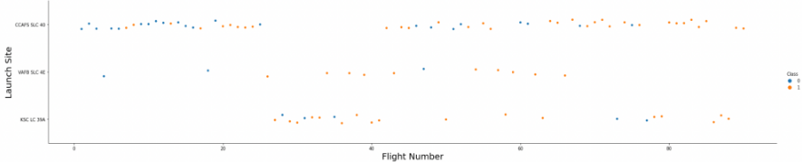
Flight Number vs. Launch Site
Explanation:
The earliest flights all failed while the latest flights all succeeded
The CCAFS SLC 40 launch site has about a half of all launches.
VAFB SLC 4E and KSC LC 39A have higher success rates
It can be assumed that each new launch has a higher rate of success

Slide 20
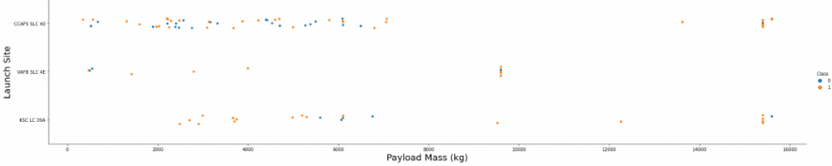
Payload vs. Launch Site
Explanation
For every launch site the higher the payload mass, the higher the success rate.
Most of the launches with payload mass over 7000 kg were successful.
KSC LC 39A has a 100% success rate for payload mass under 5500 kg too

Slide 21
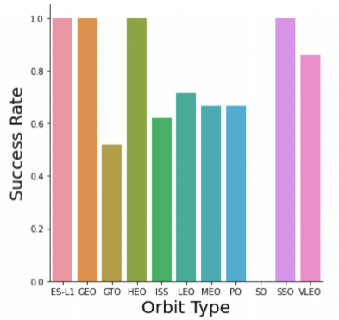
Success Rate vs. Orbit Type
Explanation:
Orbits with 100% success rate:
ES-L1, GEO, HEO, SSO
Orbits with 0% success rate:
SO
Orbits with success rate between 50% and 85%:
GTO, ISS, LEO, MEO, PO

Slide 22
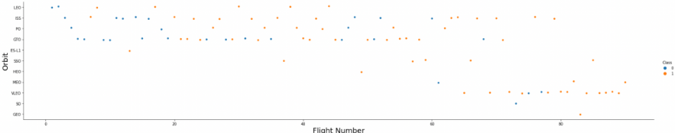
Flight Number vs. Orbit Type
Explanation
In the LEO orbit the Success appears related to the number of flights; on the other hand, there seems to be no relationship between flight number when in GTO orbit

Slide 23
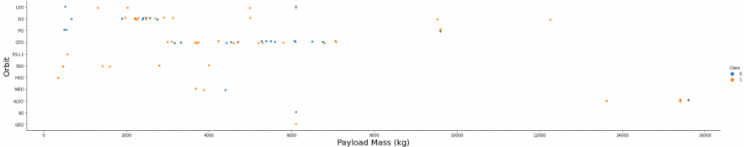
Payload vs. Orbit Type
Explanation
Heavy payloads have a negative influence on GTO orbits and positive on GTO and Polar LEO (ISS) orbits

Slide 24
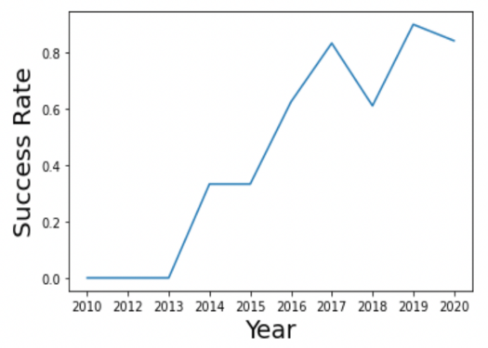
Launch Success Yearly Trend
Explanation:
The success rate since 2013 kept increasing till 2020.

Slide 25
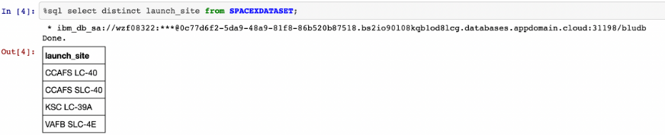
All Launch Site Names
Explanation
Displaying the names of unique launch sites in the space mission

Slide 26
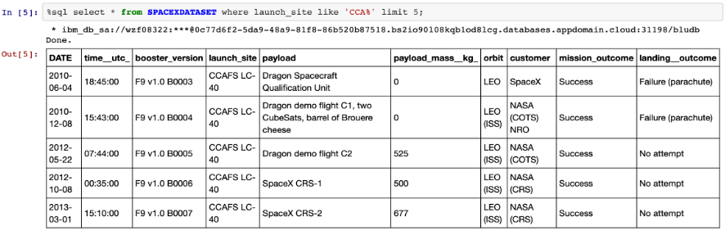
Launch Site Names Begin with 'CCA'
Explanation
Displaying 5 records where launch sites begin with the string 'CCA'.

Slide 27
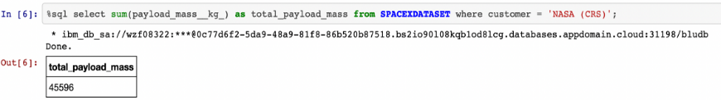
Total Payload Mass
Explanation
Displaying the total payload mass carried by boosters launched by NASA (CRS).

Slide 28
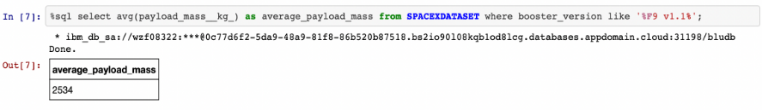
Average Payload Mass by F9 v1.1
Explanation
Displaying average payload mass carried by booster version F9 v1.1

Slide 29
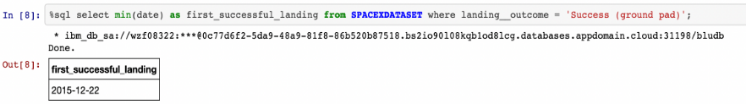
First Successful Ground Landing Date
Explanation
Listing the date when the first successful landing outcome in ground pad was achieved

Slide 30
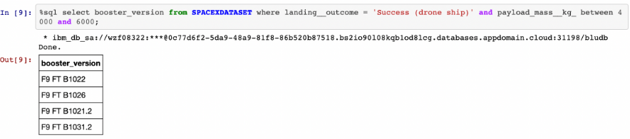
Successful Drone Ship Landing with Payload between 4000 and 6000
Explanation
Listing the names of the boosters which have success in drone ship and have payload mass greater than 4000 but less than 6000.

Slide 31
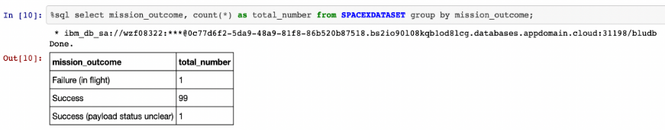
Total Number of Successful and Failure Mission Outcomes
Explanation
Listing the total number of successful and failure mission outcomes.

Slide 32
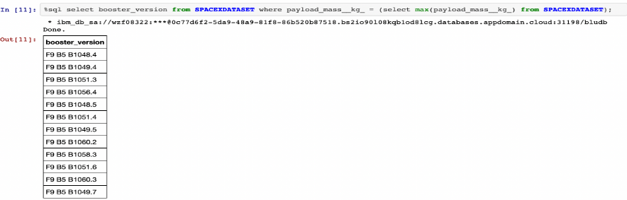
Boosters Carried Maximum Payload
Explanation
Listing the names of the booster versions which have carried the maximum payload mass

Slide 33
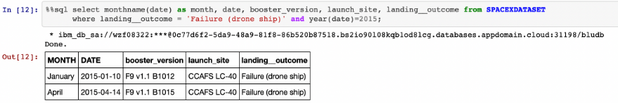
2015 Launch Records
Explanation
Listing the failed landing outcomes in drone ship, their booster versions and launch site names for the months in year 2015

Slide 34
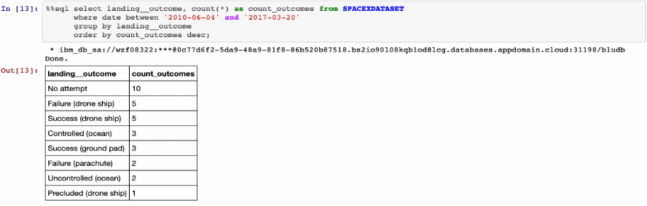
Rank Landing Outcomes Between 2010-06-04 and 2017-03-20
Explanation
Ranking the count of landing outcomes (such as Failure (drone ship) or Success (ground pad)) between the date 2010-06-04 and 2017-03-20 in descending order

Slide 35

Section 3

Slide 36
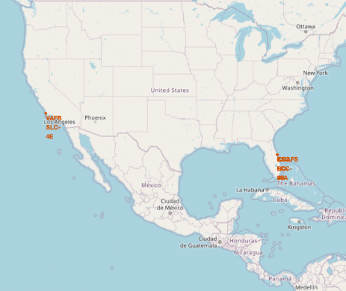
All launch sites’ location markers on a global map
Explanation:
Most of Launch sites are in proximity to the Equator line. The land is moving faster at the equator than any other place on the surface of the Earth. Anything on the surface of the Earth at the equator is already moving at 1670 km/hour. If a ship is launched from the equator it goes up into space, and it is also moving around the Earth at the same speed it was moving before launching. This is because of inertia. This speed will help the spacecraft keep up a good enough speed to stay in orbit.
All launch sites are in very close proximity to the coast, while launching rockets towards the ocean it minimises the risk of having any debris dropping or exploding near people

Slide 37
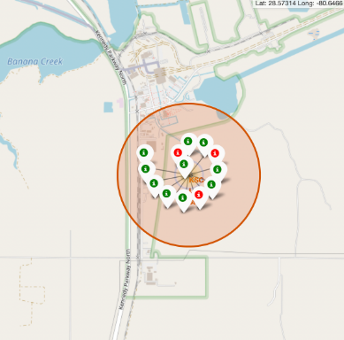
<Folium Map Screenshot 2>
Explanation:
From the color-labeled markers we should be able to easily identify which launch sites have relatively high success rates.
Green Marker = Successful Launch
Red Marker = Failed Launch
Launch Site KSC LC-39A has a very high Success Rate.

Slide 38
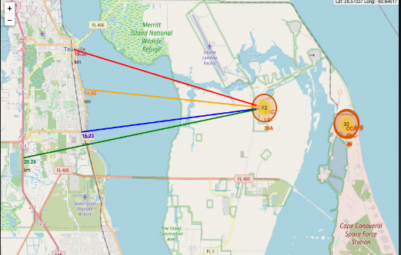
Distance from the launch site KSC LC-39A to its proximities
Explanation:
From the visual analysis of the launch site KSC LC-39A we can clearly see that it is:
relatively close to railway (15.23 km)
relatively close to highway (20.28 km)
relatively close to coastline (14.99 km)
The launch site KSC LC-39A is relatively close to its closest city Titusville (16.32 km).
Failed rocket with its high speed can cover distances like 15-20 km in few seconds. It could be potentially dangerous to populated areas.

Slide 39

Section 4

Slide 40
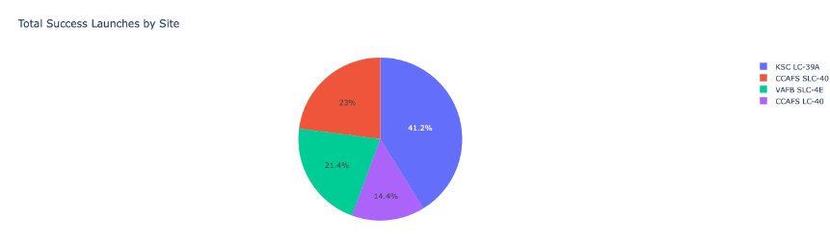
Launch success count for all sites
Explanation:
The chart clearly shows that from all the sites, KSC LC-39A has the most successful launches.

Slide 41
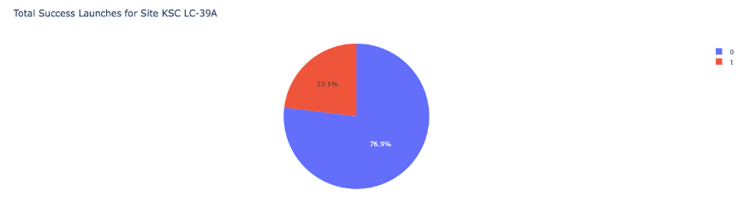
Launch site with highest launch success ratio
Explanation:
KSC LC-39A has the highest launch success rate (76.9%) with 10 successful and only 3 failed landings.

Slide 42
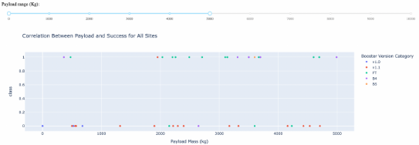
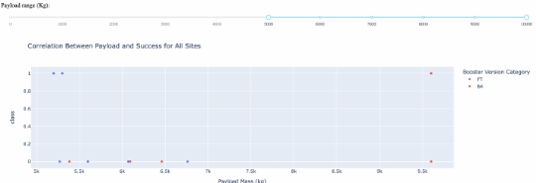
Payload Mass vs. Launch Outcome for all sites
Explanation:
The charts show that payloads between 2000 and 5500 kg have the highest success rate

Slide 43

Section 5

Slide 44
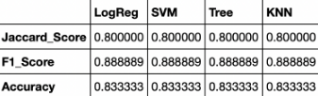
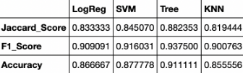
Classification Accuracy
Explanation:
Based on the scores of the Test Set, we can not confirm which method performs best.
Same Test Set scores may be due to the small test sample size (18 samples). Therefore, we tested all methods based overall Dataset.
The scores of the whole Dataset confirm that the best model is the Decision Tree Model. This model has not only higher scores, but also the highest accuracy.
Scores and Accuracy of the Test Set
Scores and Accuracy of the Entire Data Set

Slide 45
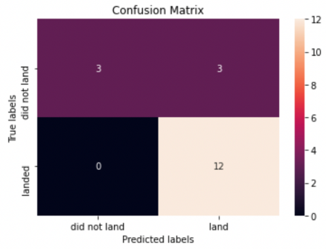
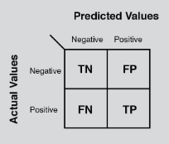
Confusion Matrix
Explanation:
Examining the confusion matrix, we see that logistic regression can distinguish between the different classes. We see that the major problem is false positives

Slide 46
Conclusions
Decision Tree Model is the best algorithm for this dataset.
Launches with a smaller payload mass show better results than launches with a larger payload mass.
Most of launch sites are in proximity to the Equator line and all the sites are in very close proximity to a coast of a large body of water.
The success rate of launches increases over the time.
KSC LC-39A has the highest success rate of all the launch sites.
Orbits ES-L1, GEO, HEO and SSO have 100% success rate.

Slide 47


